Slide 1
PSCS_202_Smart Irrigation System for Precision
CSE7101- Capstone Project
Review-2
Batch Number : CSE_137
Under the Supervision of,
Ms. Swetha K H
School of Computer Science and Engineering
Presidency University
Roll Number | Student Name
20221CSE0433 | Mekala Prakash
20221CSE0439 | Bana Tejeswar Reddy
20221CSE0447 | Bella Vishnu Vardhan
Name of the Program : CSE
Name of the HoD: Dr. Asif Mohammed
Name of the Program Project Coordinator: Dr . Jayavadivel Ravi
Name of the School Project Coordinators: Dr .Sampath A K , Dr. Geetha A

Slide 2
Problem Statement Number: PSCS_647
Organization: Presidency University
Category (Hardware / Software / Both) : Both (IoT-based hardware with software integration)
Problem Description:
“The project focuses on developing a smart irrigation system using IoT sensors and microcontrollers to monitor soil and weather conditions in real-time, automate irrigation, conserve water, and enhance crop yield with minimal manual effort.”

Slide 3
Content
Abstract
Literature Survey
Objectives
Existing Methods and Drawbacks
Proposed Method & Feasibility Study
Modules
Hardware and Software Details
Timeline (Gantt Chart)
References

Slide 4
Abstract:
Agriculture today suffers from challenges such as water scarcity and inefficient irrigation techniques.
To overcome these issues, the Internet of Things (IoT) provides intelligent solutions that enable real-time monitoring of soil and environmental conditions, leading to efficient water usage and better crop yield.
This project presents an IoT-based Smart Irrigation System designed for precision farming.
It integrates sensors, microcontrollers, and cloud platforms to automate irrigation based on soil moisture and weather data.
The outcomes highlight improved water conservation, sustainable farming, and optimized crop production.

Slide 5
Literature Survey (Overview) :
Paper (Year) | Problem Studied | Approach | Findings | Gap
Dursun & Ozden (2011) | Manual irrigation wastes water and labor | Wireless drip irrigation with soil moisture sensors | Saved water, increased efficiency | No remote/cloud monitoring
Rawal & Doshi (2016) | Lack of remote control in irrigation | Arduino + GSM-based IoT irrigation | Enabled irrigation via SMS | Only basic automation, no prediction
García et al. (2020) | High water consumption in farming | IoT sensors + cloud platform | 20–30% water saving | Limited field validation
Mukherjee & Singh (2020) | Poor irrigation scheduling | Arduino + ESP8266 with sensors | IoT dashboard improved decisions | No AI/ML forecasting
Vallejo-Gómez et al. (2023) | Unreliable scheduling in traditional methods | Review of IoT + AI irrigation systems | AI improves scheduling accuracy | Costly and complex for small farmers
Ali et al. (2025) | Inefficient water use in large farms | IoT, wireless sensor networks, deep learning | Better water efficiency | Needs stable internet, high computation
Zhang et al(2025) | Delay in cloud-only systems | Edge computing with LoRa + Raspberry Pi gateway | Reduced latency, faster decisions | High hardware cost
Kunt (2025) | Lack of intelligent autonomous irrigation | IoT (ESP32 + sensors) + AI (LSTM) + mobile app | AI-driven irrigation, mobile alerts | Needs training data, complex setup

Slide 6
Objectives :
To design and develop an IoT-based smart irrigation system for precision farming.
To monitor real-time soil and environmental parameters (moisture, temperature, humidity, etc.) using sensors.
To automate irrigation by controlling water pumps/valves based on sensor data.
To optimize water usage and minimize wastage, ensuring sustainable agriculture.
To improve crop yield and productivity through precise irrigation techniques.
To improve crop yield and productivity through precise irrigation techniques.

Slide 7
Existing Methods & Drawbacks :
IoT-Enabled Systems:
  Method: Soil moisture sensors and microcontrollers are used to automate irrigation partially.
  Drawback: Limited scalability, high initial cost, often lack environmental adaptability, and may not integrate weather forecasting or data analytics.
Timer-Based Irrigation:
    Method: Irrigation is scheduled at fixed intervals using timers.
    Drawbacks: Ignores soil moisture and weather conditions, leads to water
    wastage during rainy days, and inadequate supply in dry periods.

Slide 8
Proposed Method :
Data Collection: Deploy IoT sensors and gather weather and satellite data for real-time field monitoring.
Data Storage: Store all sensor and environmental data in a time-series optimized database.
Data Processing: Use Python/ML to analyze soil moisture, crop water needs, and detect anomalies.
Control & Automation: Automate irrigation through smart valves and pumps based on analysis.
Visualization: Provide interactive dashboards with maps, charts, and trend analysis.
Security: Implement role-based access and secure communication for users and devices.
Scalability: Design modular system to add sensors, expand fields, or integrate regionally.

Slide 9
Feasibility Study :
Technical Feasibility: Existing IoT sensors, automation devices, and data analysis tools can support the system.
Economic Feasibility: Investment in sensors and automation is recoverable through water savings, higher yields, and reduced labor costs.
Operational Feasibility: Farmers can easily monitor and control irrigation remotely with minimal training.
Environmental Feasibility: Optimized water usage conserves resources and supports sustainable farming.
Risk Feasibility: System risks like sensor failure or connectivity issues can be managed with alerts and manual overrides.

Slide 10
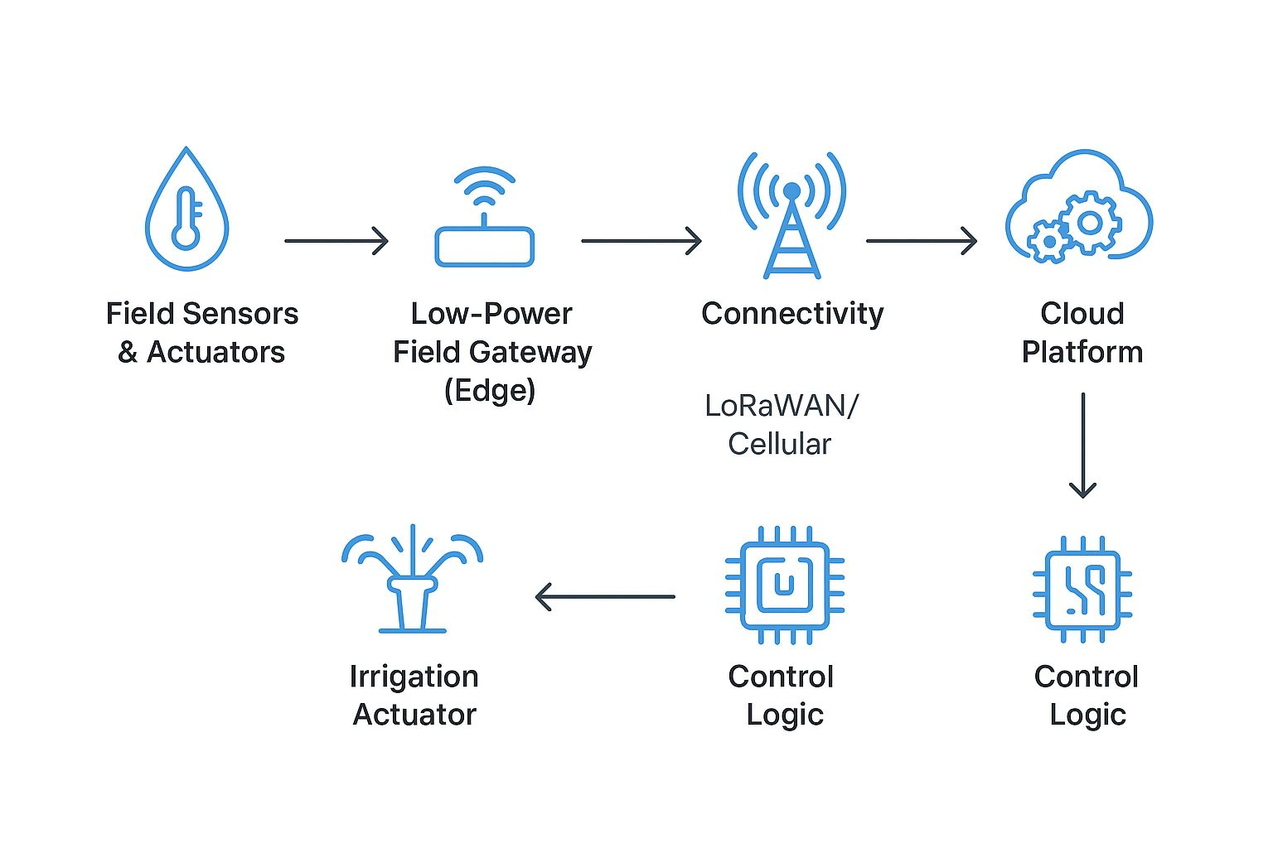
Architecture Diagram & Explanation :
Field Sensors & Actuators → Measure soil moisture, temperature, humidity, and control valves/pumps.
Low-Power Field Gateway (Edge) → Collects sensor data, preprocesses, and sends to cloud.
Connectivity → Provides wireless data transmission from field to cloud.
Cloud Platform → Stores data, runs analytics, and provides dashboards.
Control Logic (Cloud/Edge) → Decides when and how much to irrigate based on data.
Irrigation Actuator → Executes irrigation commands through valves, pumps, or sprinklers.

Slide 11
Modules :
Sensor (Data Acquisition) Module: Gathers real-time environmental parameters (soil moisture, temperature, humidity) for decision-making.
Edge Processing (Controller) Module: Uses a microcontroller to process sensor data, implement threshold logic or AI, and operate the water pump via relay.
Communication Module: Enables data exchange and system connectivity—often via Wi‑Fi or cloud platforms.
User Interface Module: Provides real-time monitoring and manual override capabilities via mobile apps (e.g., Blynk).

Slide 12
Technology Stack(Hardware and Software Details) :
Layer | Technology | Purpose | Why Chosen | Role in Project
Sensing Layer | Moisture, Temp, Humidity, pH Sensors | Collect field and soil data | Low cost, accurate, easy to use | Provides input data for irrigation
Control Layer | Arduino / ESP8266 / ESP32 | Process sensor data, control pumps | Low power, simple programming | Acts as the brain of the system
Communication Layer | Wi-Fi / GSM / LoRa | Send data to cloud/server | Reliable, flexible range | Ensures remote monitoring
Actuation Layer | Water Pump, Valves, Relays | Automate water flow | Easy to integrate with micro controller unit | Executes irrigation decisions
Power Layer | Solar Panel + Battery | Power the system in fields | Renewable, reliable | Continuous power supply
Gateway Layer | Raspberry Pi | Local processing, send to cloud | Compact, supports Python/Linux | Preprocesses and forwards data

Slide 13
Timeline of the Project (Gantt Chart)
August 2025: Requirement gathering and design.
September 2025: Literature Survey, Methods & Proposed Architecture
October 2025: Frontend development and visualization.
November 2025: Testing and deployment.
December 2025: Final documentation and review.

Slide 14
Academic References :
No. | Title & Authors | Publication Year | Key Focus
1. | "An overview of smart irrigation systems using IoT" by K.Obaideen et al. | 2022 | Highlights the role of IoT and sensory systems in irrigation for sustainable development (article)
2. | "IoT-Based Smart Irrigation Systems: An Overview" by L. García et al. | 2020 | Broad survey of IoT-based irrigation, covering numerous platforms and techniques (PMC)
3. | "Smart Irrigation Technologies and Prospects for Enhancing Water Use Efficiency for Sustainable Agriculture" by A. Ali et al. | 2025 | Analyzes precision monitoring, IoT, wireless sensor systems, deep learning, and control strategies (ResearchGate)
4. | "Development of an IoT Smart Irrigation …" by Y. Zhang et al. (MDPI) | 2025 | Describes an edge-computing architecture using MCU for real-time irrigation control (MDPI)
5. | "Development of IoT and AI based Smart Irrigation System" (arXiv) by Yunus Emre Kunt | 2025 | Integrates IoT (ESP32, sensors) with LSTM-based AI and mobile app for autonomous drip irrigation (arXiv)
6. | "Smart IoT-driven precision agriculture: Land mapping, crop prediction, and irrigation system" by G. Saha et al. (PLoS ONE) | 2025 | Offers an integrated solution encompassing land mapping, crop selection, solar-powered irrigation with ML and fuzzy logic (PLOS)
7. | "Smart Irrigation Systems in Agriculture: A Systematic Review" by D. Vallejo-Gómez et al. | 2023 | A systematic PRISMA-based review of AI-enabled smart irrigation systems in both rural and urban contexts (ResearchGate)
8. | "Intelligent and automatic irrigation system based on …" by X. Liu et al. | 2025 | Examines fuzzy logic and blockchain-based secure IoT irrigation systems for precision control (Nature)

Slide 15
Github Link
The Github link provided should have public access permission.
Github Link

Slide 16


